Slide 1
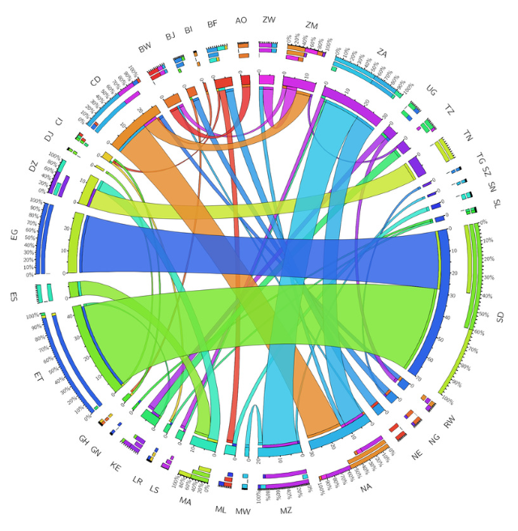
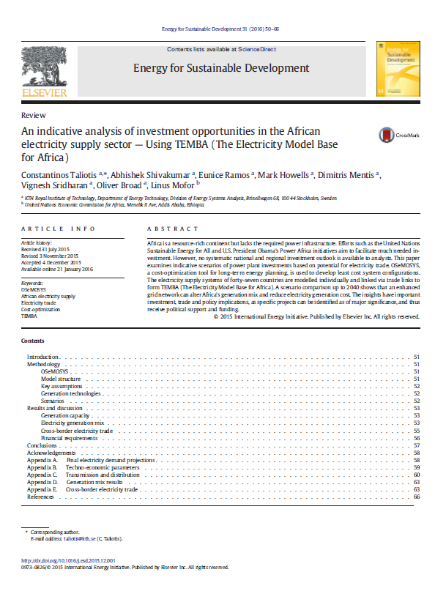
Three continental applications
TEMBA – The Electricity Model Base for Africa
(partners: World Bank, JRC, UN, SIDA, ABB, Vetenskaprådet)
Scope: Assess resilience of African electricity infrastructure to climate change and role of interconnections
Modules: Electricity, Gas, 1000+ technologies and fuels
Spatial scale: Africa – one node per country
Temporal scale: Year divided in 8 time slices – 4 seasons, 1 typical day, 2 daily time brackets (Night and Day)

Slide 2
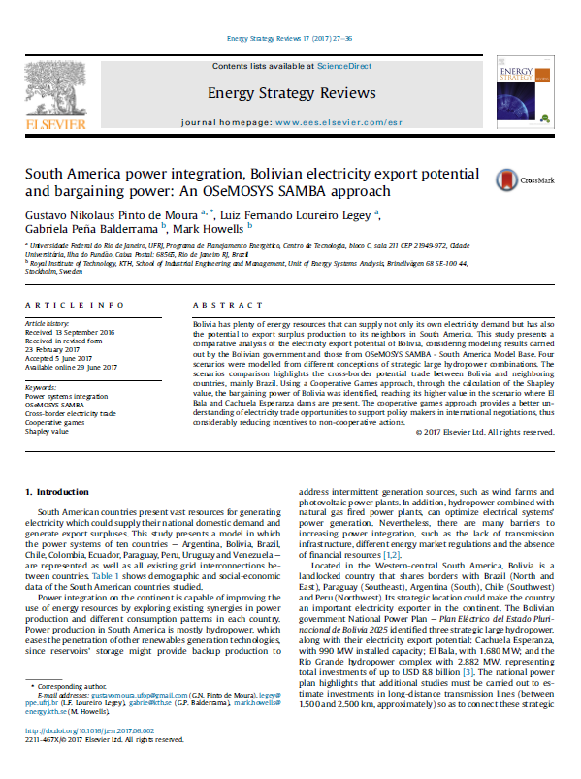
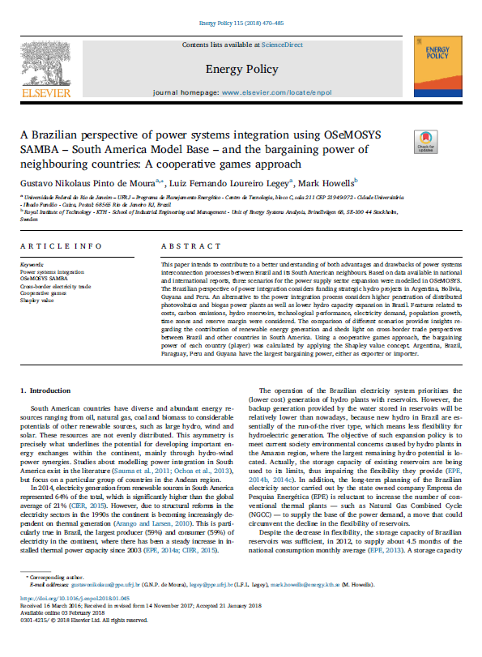
Three continental applications
SAMBA – South America Model Base
(partners: World Bank)
Scope: South America Model Base, electricity supply infrastructure modelling to study cooperation dynamics between countries
Modules: Electricity, 16 technologies per country
Spatial scale: 11 countries, one node per country
Temporal scale: Year divided in 48 time slices – 12 seasons (one per month), 1 typical day, 4 daily time brackets of 6 hours each

Slide 3
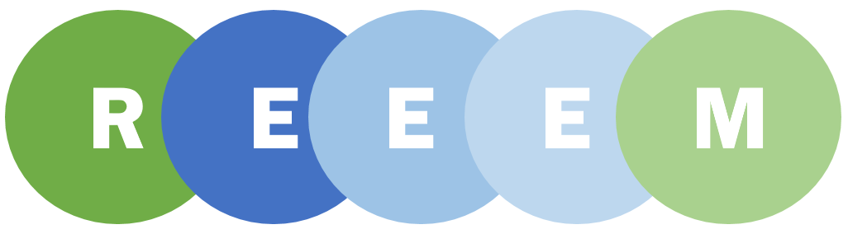
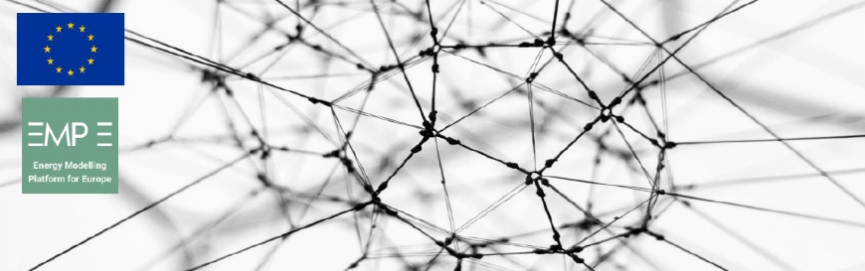
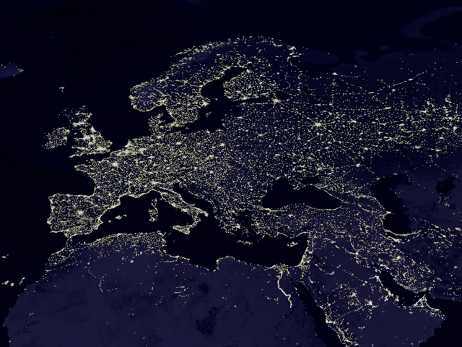
Three continental applications
OSeMBE – Open Source energy Model Base for Europe
(funded by the EC)
Scope: Open Source energy Model Base for the EU – EU28+2 electricity system model to represent key dynamics of the transition to a low-carbon system
Modules: Electricity, 1000+ technologies and fuels
Spatial scale: EU28+2 – one node per country
Temporal scale: Year divided in 15 time slices – 5 seasons, 1 typical day, 3 daily time brackets (Night, Day and Peak)
Source: Wikipedia

